Slide 1

Computer Graphics
Prepared By: Bahram Taheri
Sept. 2006
Amirkabir University of Technology
&
Birmingham University

Slide 2
Geometric Transformations
2D and 3D Transformations
Translation (Deals with position)
Scaling (Deals with size)
Rotation (Deals with orientation)

Slide 3
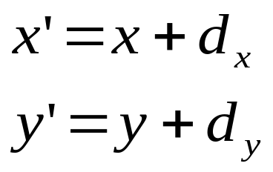
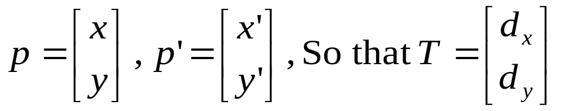
2D Transformation
Translating Points in the (x, y) Plane
Moving point p(x,y) to p’(x’,y’) so that
Consider the following column vectors:

Slide 4
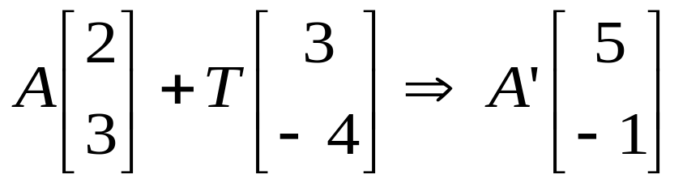
Example of Translation
Translate the following figure by T(3, -4)
y
B
7
3
A
C
x
2
5
This can be simply shown as
A’=A+T

Slide 5
Translation
Translated Figure
3
B
5
8
x
-1
A
C

Slide 6
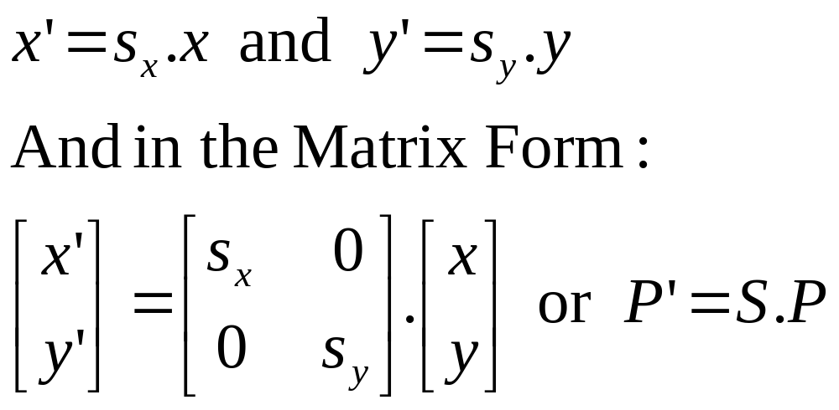
Scaling
Points Can be Stretched or Shrunken into New Points along the x and y directions by the Following Multiplications:

Slide 7
Scaling
Scaling is about the size as well as distance from the Origin
If the Scaling Factors Are Smaller than 1 then the Figure will become Smaller as Well as Closer to the Origin
If the Scaling Factor is Larger than One, then the Figure will become Larger and Further from the Origin.

Slide 8
Scaling
Let’s scale the following triangle by ½ in x direction and by 1/3 in y direction.
y
B
7
3
A
C
x
2
3.5
5

Slide 9
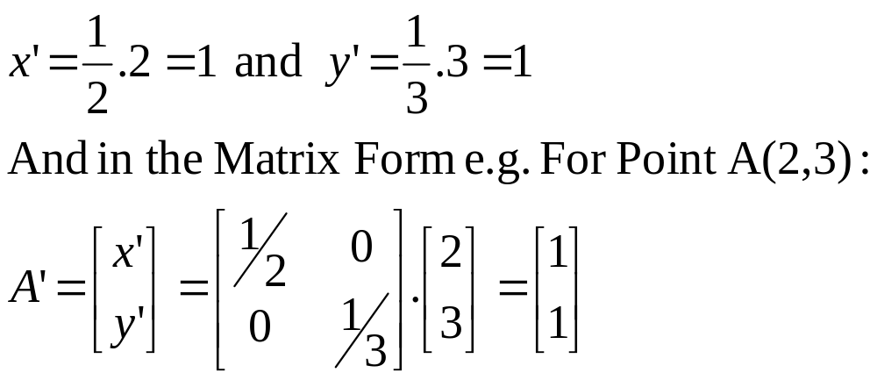
Matrix Transformation of a Scaled Figure

Slide 10
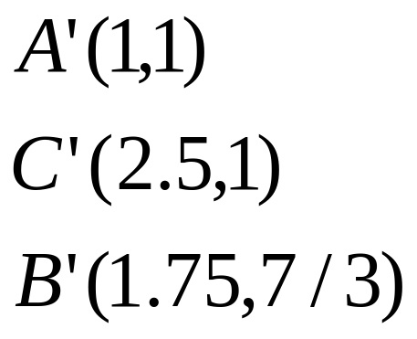
Scaled Shape
y
B
7
3
A
C
x
2
5

Slide 11
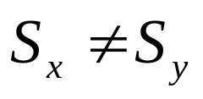
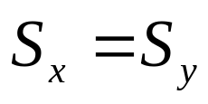
Some Points About Scaling
Scaling Can be Performed around a Point Other than the Origin
In Differential Scaling,
In Uniform Scaling,

Slide 12

Study on origin of 2 methods of scaling
Prepared By:
Hadi Khayyamian
Vala Namdarpour
Mechanical Eng. 1st Year
Birmingham-AUT
Feb. 2008

Slide 13
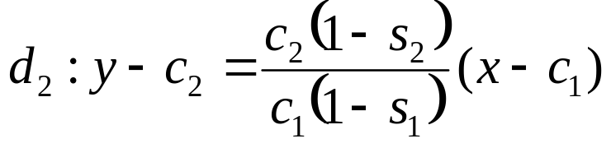

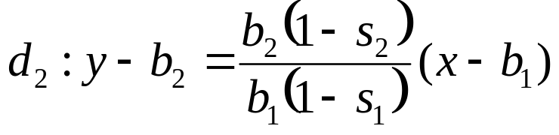

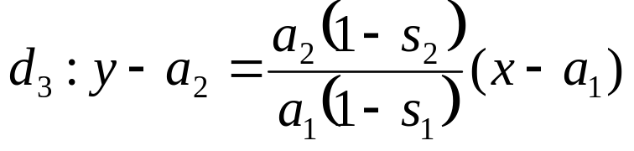
First method : Scaling with identical proportionality
Here, x-axis coefficient ( s₁) & y-axis coefficient (s₂) are the same.
c₂
b₂
d₁
a₂
d₂
c₂
b₂
d₃
a₂
a₁
a₁
c₁
b₁
c₁
b₁

Slide 14


And point via intersecting d₁ and d₂ ,when s₁= s₂ ,is: origin (0 , 0)
point via intersecting d₃ and d₂ ,when s₁= s₂ ,is: origin (0 , 0)
point via intersecting d₁ and d₃ ,when s₁= s₂ ,is: origin (0 , 0)
So they have common origins

Slide 15
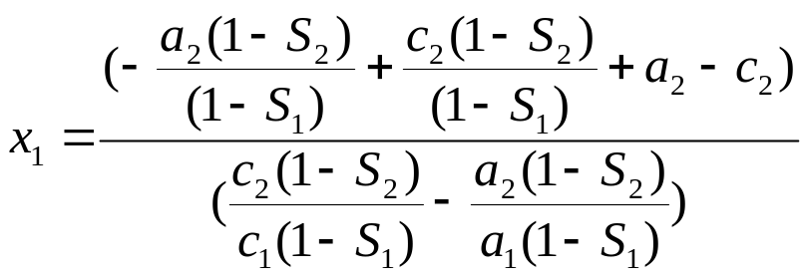

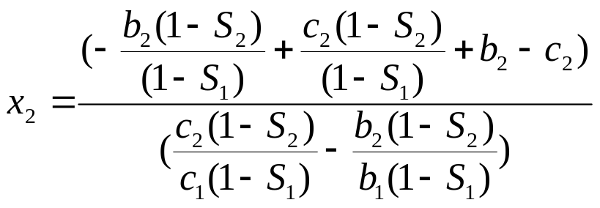

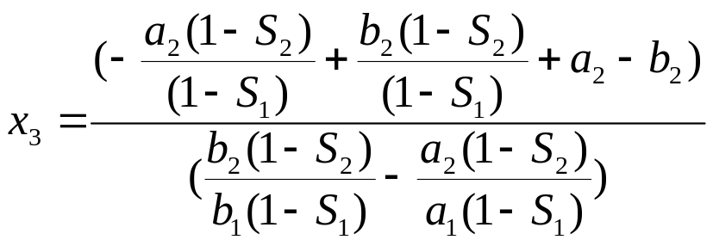
second method : differential scaling ( S₁≠ S₂)
(x₂ ,y₂)
(x₃ ,y₃)
(x₁,y₁)

Slide 16
In this case you can see that x₁ ≠ x₂ ≠ x₃ so their points are different.
So they have different origins

Slide 17
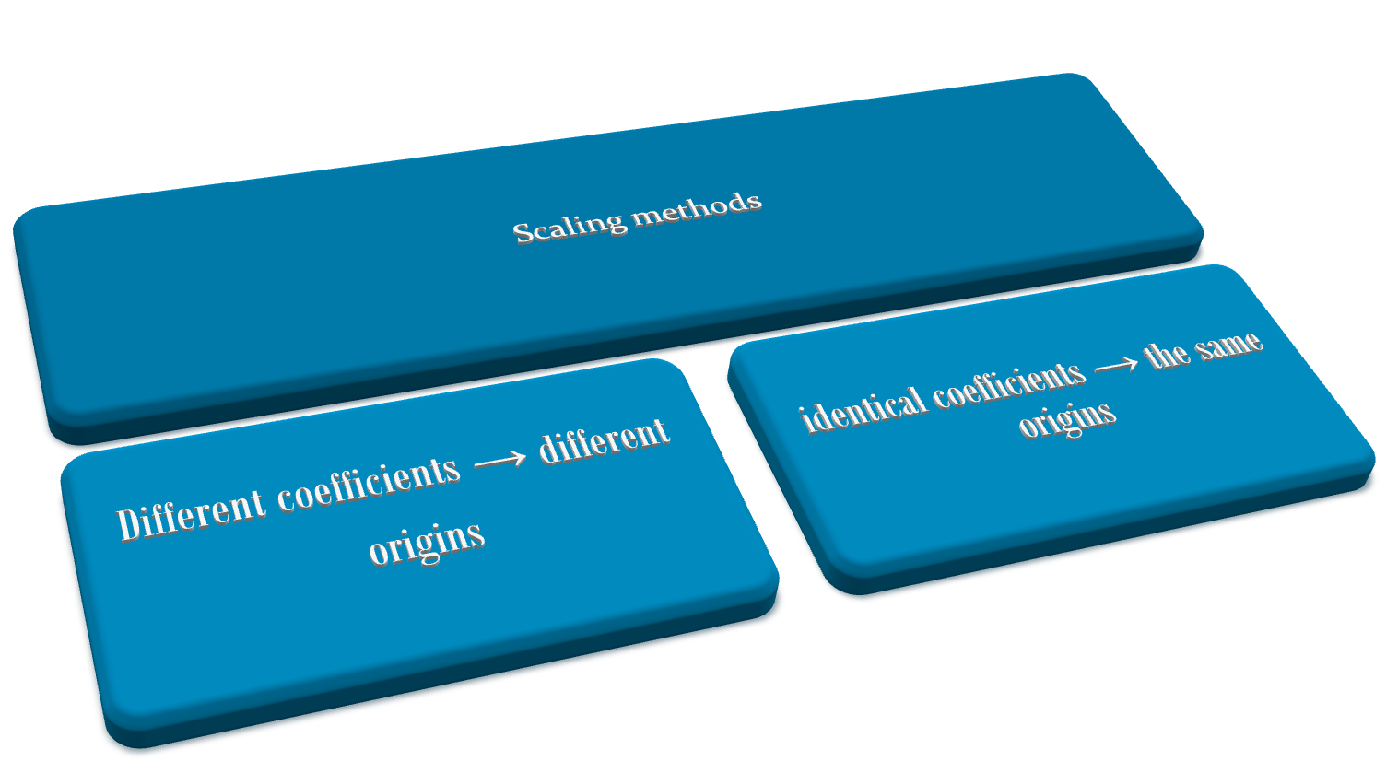

Slide 18
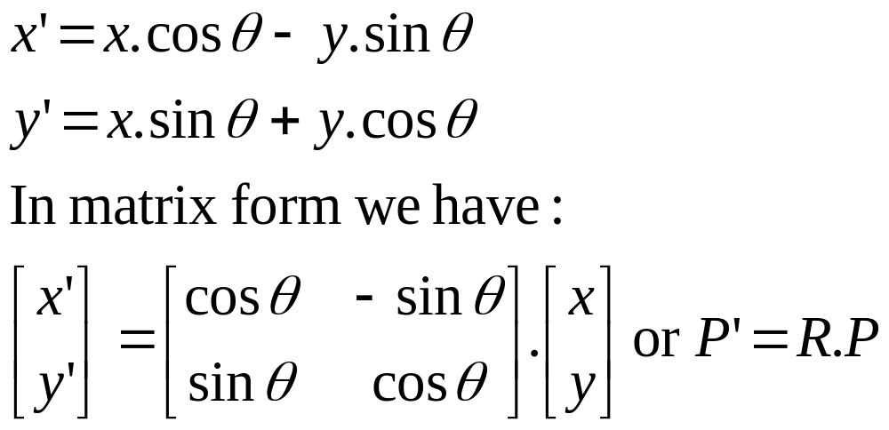
Rotation of A Figure
A Figure Can Be Usually Rotated About a Point Through an Angle in a Specific Direction
The Mathematical Definition of Rotation is:

Slide 19
Rotation
The Given Rotation Formulas Are About the Origin
Rotation Can be About Any Arbitrary Point
Counterclockwise Rotations Are Positive
Clockwise Rotations Are Negative

Slide 20







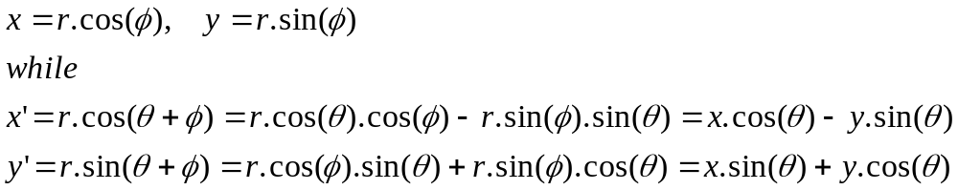
Deriving the Rotation Equation

Slide 21
Homogeneous Coordinates and Matrix Representation of 2D Transformations
The matrix representation for translation, scaling and rotation are:
P’ = T+P
P’ = S*P
P’ = R*P
If we express the points in homogeneous coordinates, then we can treat all three transformations as multiplication.
In homogeneous coordinates we represent a point by a triple (x,y,W) rather than a pair (x,y).

Slide 22
Homogeneous Coordinates Continued
We say that two sets of triples (x,y,W) and (x’,y’,W’) are the same points, if and only if one set is a multiple of the other set. For example, (2,3,5) and (4,6,10) represent the same points.
At least one of the homogeneous coordinates must be nonzero.
(0,0,0) is not allowed.
If W coordinate is nonzero, we can divide the other coordinates by W to obtain the Cartesian coordinates of the point:
(x,y,W) ➔ (x/W, y/W,1) ⬅ The Cartesian coordinates!
Points with W=0 are called points at infinity.

Slide 23
The Plane Represented by W=1
Each triple is usually used to show a point in 3-D space. However, here we use it to represent points in 2-D space. Each homogeneous point, by all its representations, creates a line in the xyW coordinates. Here, W=1 represents the Cartesian representation of the homogenized points:
W
P
The line representing
Homogenized points
(x,y,W)
W=1 Plane
X
Y

Slide 24
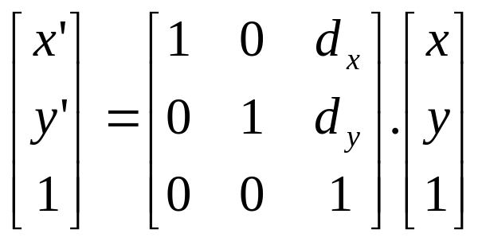
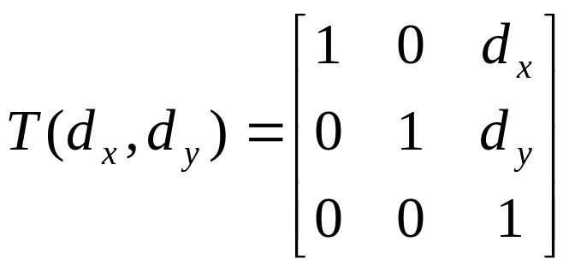
Translation in Homogenous Coordinates
The new equation becomes:
Where the translation matrix is:

Slide 25
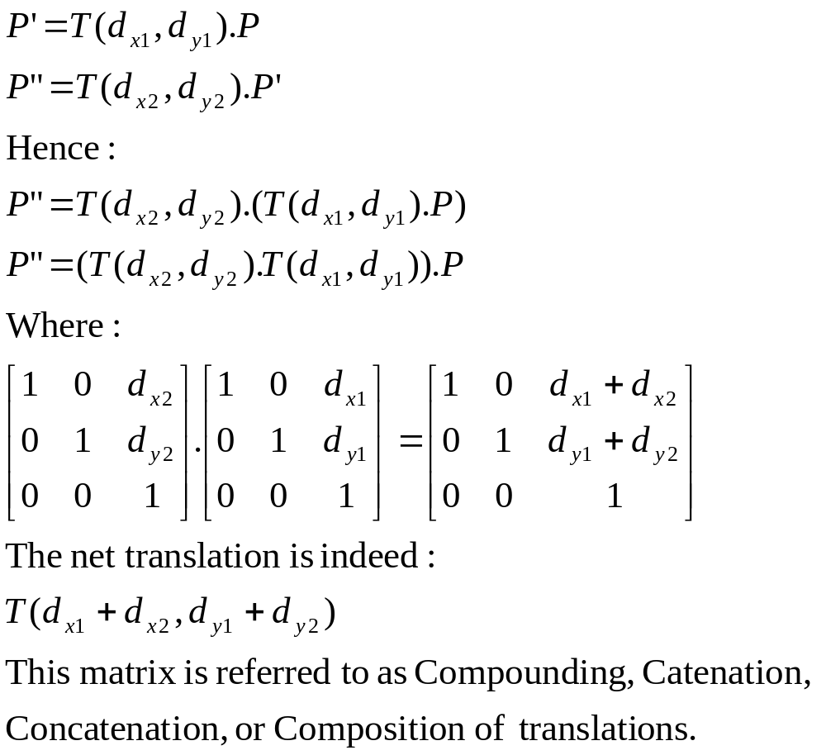
Translation + Translation in Homogeneous Coordinates

Slide 26
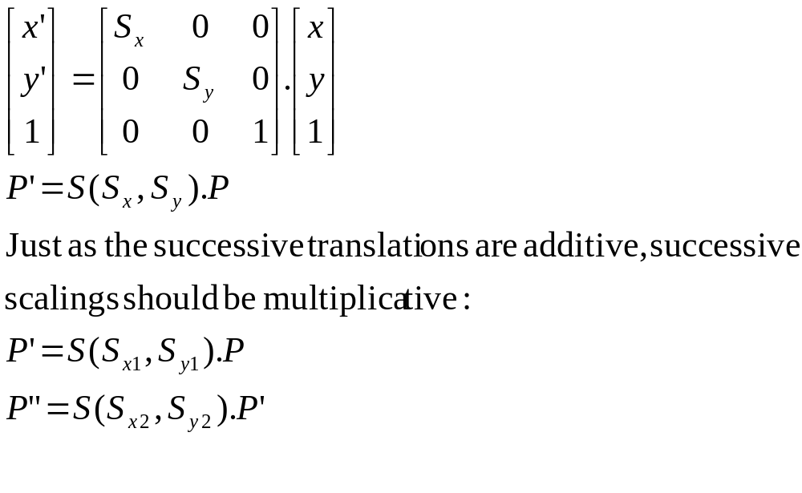
Composition of Scalings in Homogeneous Coordinates

Slide 27
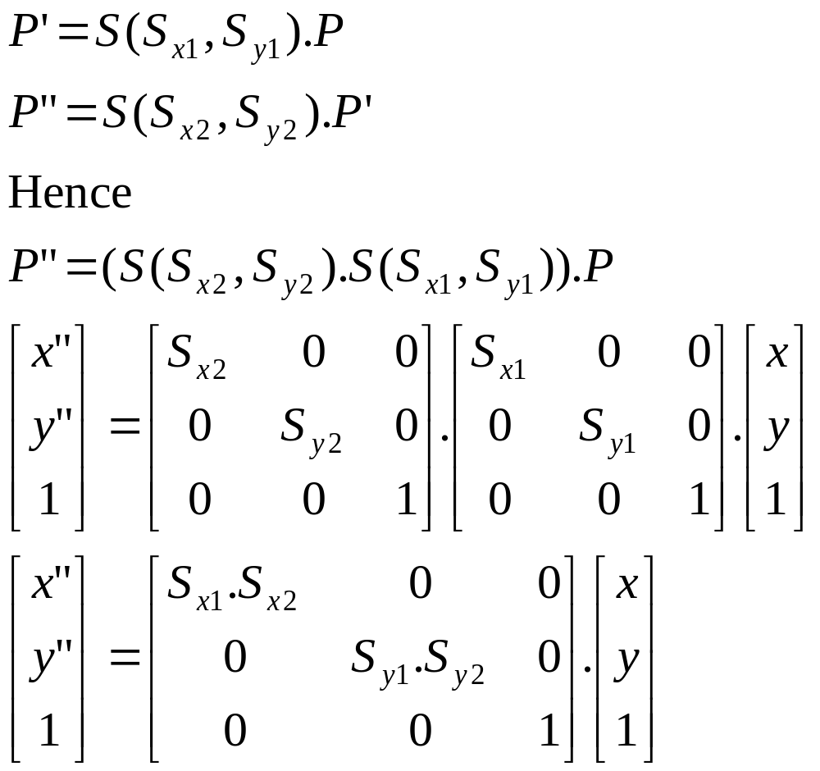

Combination of Scalings

Slide 28
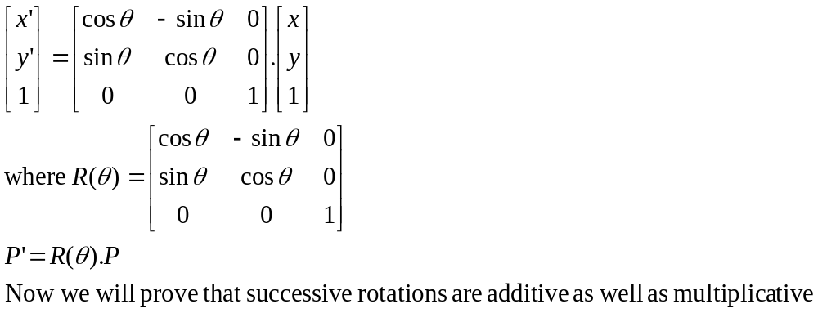
Rotation in Homogeneous Coordinates
The rotation equation is:

Slide 29
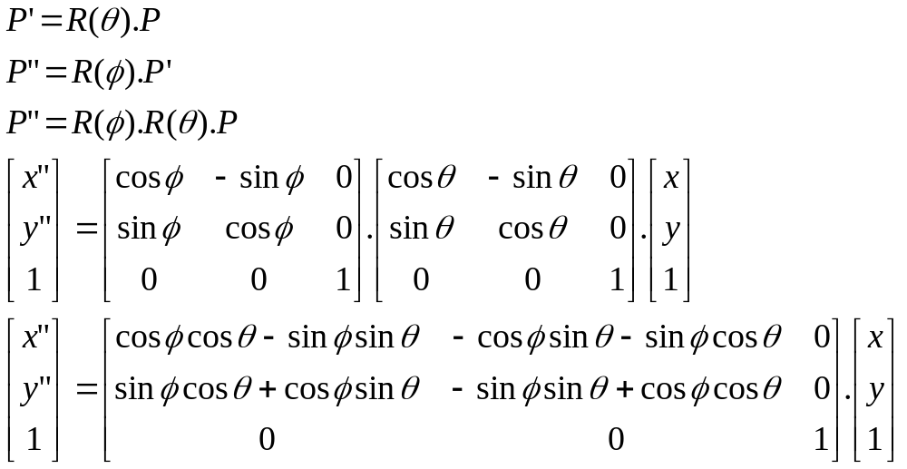
Successive Rotations

Slide 30
Borland Graphics
Video Adapters:
  Monochrome Display Adapter (MDA) for text display only
  Color/Graphics Adapter (CGA)
  Enhanced Graphics Adapter (EGA)
  Video Graphics Array adapter (VGA)
Each adapter can operate in a variety of modes:
  Screen display of 40 or 80 columns (text mode only)
  Display resolution (Graphics mode only)
  Display type (Color or black & white)

Slide 31
Screen Mode
The screen operating mode is defined when your program calls one of the mode-defining functions
  Textmode
  Initgraph
  setgraphmode

Slide 32
Text mode: Screen is divided into 40 or 80 columns (wide) and 25, 43, or 50 lines (high).
  Each cell will consist of an attribute and a character. The character will be the displayed ASCII character; the attribute specifies how the character is displayed (its color, intensity, …). The top left corner of the display screen is position (1,1),
  x-coordinate increasing from left to right
  Y-coordinate increasing from top to bottom

Slide 33
Graphics Mode: Screen is divided into pixels (what’s a pixel anyway?)
  Each pixel displays a dot onscreen.
  The number of pixels (the resolution) depends on the type of video adapter connected to your system and the mode that adapter is in.
  You can control the color of each pixel.
  The top left corner of the screen is position (1,1). With x-coordinate increasing from left to right and the y-coordinate increasing from top to bottom.

Slide 34
Windows and Viewports
Borland provides functions for creating and managing windows on your screen in the text mode.
It also provides the same for managing viewports in the graphics mode.

Slide 35
What is a Window?
A window is a rectangular area defined on your computer’s video screen while it is in the text mode.
When your program writes to the screen, its output is restricted to the active window. The rest of the screen (outside the window) remains untouched.
The default window is a full-screen text window. However, we may create smaller windows (with a call to window function) This function specifies the window’s position in terms of screen coordinates.

Slide 36
What is a View Port?
In graphics mode, we can define a rectangular area on the computer’s video screen, which is called a viewport.
The graphic output of our programs will be displayed on the viewport as a virtual screen.
The rest of the screen remains untouched (outside the viewport)
We may define a viewport in terms of the screen coordinates with a call to setviewport function.

Slide 37
Important!
Only for defining the windows or viewports we will refer to the main screen’s coordinates!
Otherwise for every other application we will refer relative to the window’s (texts) or viewport’s (graphics) coordinates.

Slide 38
Programming in the text mode
The modes available on your system depend on the type of video adapter and monitor you have. You can specify the current text mode with a call to textmode function.
Text mode functions are divided into five separate groups:
  Text output and manipulation
  Window and mode control
  Attribute control
  State query
  Cursor shape

Slide 39
Text output and manipulation functions
cprintf Sends formatted output to the screen
cputs Sends a string to the screen
getche Reads a char and echoes it to the scr.
putch Sends a single char to the screen
clreol Clears from the cursor to the end of the line
clrscr Clears the text window
delline Deletes the line where the cursor rests
gotoxy positions the cursor
insline Inserts a blank line below cursor
movetext Copies text from an area onscreen to another
gettext Copies text from an area onscreen to memory
puttext Copies text from memory to an area onscreen

Slide 40
Window and mode control functions
textmode sets the screen to a text mode
window defines a text-mode window

Slide 41
Text-mode Attribute Functions
textattr Sets the background and foreground colors at the same time
textbackground sets the background color
textcolor Sets the foreground color
highvideo Sets text to high intensity
lowvideo Sets text to low intensity
normvideo Sets text to original intensity

Slide 42
Some Points
The attribute control function uses an 8-bit value to set the background, foreground and blink attributes.
The first 4 lowest bits represent the foreground color, the next 3 bits represent the background color and the 8th bit (the highest one = 128) is for blinking.

Slide 43
State-Query Functions
gettextinfo Fills in a text_info structure with information about the current text window
wherex Gives the x-coordinate of the cell containing the cursor
wherey Gives the y coordinate of the cell containing the cursor

Slide 44
About gettextinfo function
This function fills a text_info structure (defined in conio.h) with several details about the text window, including:
  The current video mode
  The window’s position in absolute screen coordinates
  The window’s dimensions
  The current foreground and background colors
  The cursor’s current position

Slide 45
_setcursortype
This function enables you to change the appearance of your cursor. The values are:
  _NOCURSOR, which turns off the cursor
  _SOLIDCURSOR, which gives you a solid block (large) cursor
  And _NORMALCURSOR, which gives you the normal underscore cursor

Slide 46
Text Modes
Computer may operate in one of the several text modes available on your computer. The enumeration type text_modes, defined in conio.h, enables you to use symbolic names for for the mode argument rather than the raw mode numbers. However, if you use the symbolic constants, you must include conio.h in your source code.

Slide 47
Numeric and Symbolic Values for text_modes
Symbolic Constant | Numeric Value | Video Text Mode
LASTMODE | -1 | Previous text mode enabled
BW40 | 0 | Black and white, 40 columns
C40 | 1 | 16-color, 40 columns
BW80 | 2 | Black and white 80 columns
C80 | 3 | 16-color, 80 columns
MONO | 7 | Monochrome, 80 columns
C4350 | 64 | EGA, 80X43; VGA, 80X50

Slide 48
Examples of Using Symbolic Constants and Numeric Values
Syntax | Operating Mode | Library
Textmode(0) | Black and white, 40 columns
Textmode(BW80) | Black and white, 80 columns | conio.h
Textmode(C40) | 16-color, 40 columns | conio.h
Textmode(3) | 16-color, 80 columns
Textmode(7) | Monochrome, 80 columns
Textmode(C4350) | EGA, 80X43; VGA, 80X50 | conio.h

Slide 49
Colors
Symbolic Constants | Numeric Value | Foreground or background
BLACK | 0 | Both
BLUE | 1 | Both
GREEN | 2 | Both
CYAN | 3 | Both
RED | 4 | Both
MAGENTA | 5 | Both
BROWN | 6 | Both
LIGHTGRAY | 7 | Both
DARKGRAY | 8 | Foreground only
LIGHTBLUE | 9 | Foreground only
LIGHTGREEN | 10 | Foreground only
LIGHTCYAN | 11 | Foreground only
LIGHTRED | 12 | Foreground only
LIGHTMAGENTA | 13 | Foreground only
YELLOW | 14 | Foreground only
WHITE | 15 | Foreground only
BLINK | 128 | Foreground only

Slide 50
initgraph
Syntax
#include <graphics.h>
void initgraph(int *graphdriver, int *graphmode, char *pathtodriver);
Description
initgraph initializes the graphics system by loading a graphics driver from disk (or validating a registered driver), and putting the system into graphics mode.
To start the graphics system, first call the initgraph function. initgraph loads the graphics driver and puts the system into graphics mode. You can tell initgraph to use a particular graphics driver and mode, or to autodetect the attached video adapter at run time and pick the corresponding driver.

Slide 51
initgraph
If you tell initgraph to autodetect, it calls detectgraph to select a graphics driver and mode. initgraph also resets all graphics settings to their defaults (current position, palette, color, viewport, and so on) and resets graphresult to 0.
Normally, initgraph loads a graphics driver by allocating memory for the driver (through _graphgetmem), then loading the appropriate BGI file from disk. As an alternative to this dynamic loading scheme, you can link a graphics driver file (or several of them) directly into your executable program file.
pathtodriver specifies the directory path where initgraph looks for graphics drivers. initgraph first looks in the path specified in pathtodriver, then (if they are not there) in the current directory. Accordingly, if pathtodriver is null, the driver files (*.BGI) must be in the current directory. This is also the path settextstyle searches for the stroked character font files (*.CHR).

Slide 52
graphdriver
*graphdriver is an integer that specifies the graphics driver to be used. You can give it a value using a constant of the graphics_drivers enumeration type, which is defined in graphics.h and listed below.

Slide 53
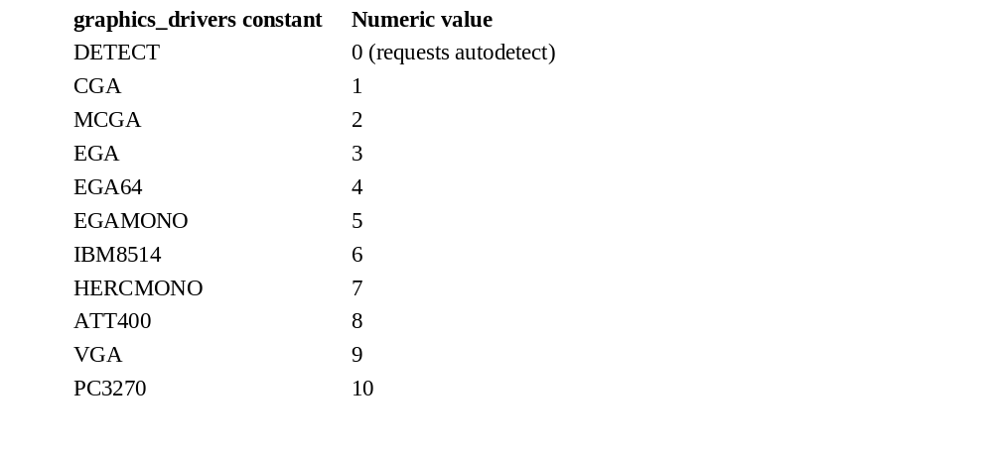
Graphics_deiver constants

Slide 54
graphmode
*graphmode is an integer that specifies the initial graphics mode (unless *graphdriver equals DETECT; in which case, *graphmode is set by initgraph to the highest resolution available for the detected driver). You can give *graphmode a value using a constant of the graphics_modes enumeration type, which is defined in graphics.h and listed below.
graphdriver and graphmode must be set to valid values from the following tables, or you will get unpredictable results. The exception is graphdriver = DETECT.
Palette listings C0, C1, C2, and C3 refer to the four predefined four-color palettes available on CGA (and compatible) systems. You can select the background color (entry #0) in each of these palettes, but the other colors are fixed.

Slide 55
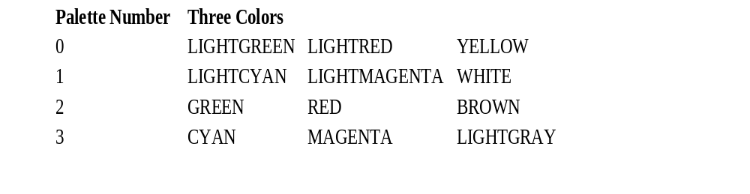
Pallete Colors

Slide 56
Return Value
initgraph always sets the internal error code; on success, it sets the code to 0. If an error occurred, *graphdriver is set to -2, -3, -4, or -5, and graphresult returns the same value as listed below:

Slide 57
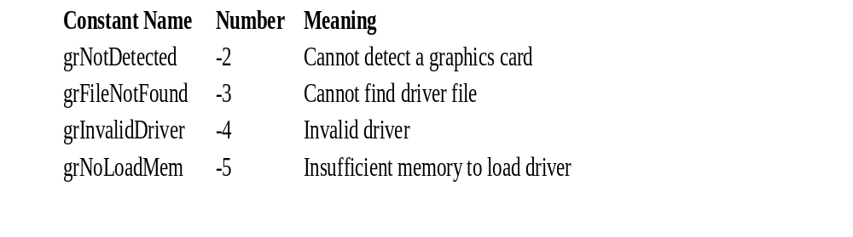
Error codes

Slide 58
Graph error messages
Syntax
#include <graphics.h> //In DOS mode
char * grapherrormsg(int errorcode);
Description
grapherrormsg returns a pointer to the error message string associated with errorcode, the value returned by graphresult.
Return Value
grapherrormsg returns a pointer to an error message string.

Slide 59
Set color
Syntax
#include <graphics.h>
void setcolor(int color);
Description
setcolor sets the current drawing color to color, which can range from 0 to getmaxcolor. The current drawing color is the value to which pixels are set when lines, and so on are drawn. The drawing colors shown below are available for the CGA and EGA, respectively.

Slide 60
